Slide 1
Example of VSM
Document 1 (D1): "The cat sat on the mat."
Document 2 (D2): "The dog sat on the log."
Query (Q): "cat and dog"
1. Vocabulary: [Cat, sat, mat, dog, log]
2. Compute term frequency with log
TF(t,d)=log10​(1+ft,d​)
3. Compute IDF
IDF(t)=log10​(N/nt​)
4. TF.IDF Score
TF-IDF(t,d)=TF(t,d)×IDF(t)
5. Compute cosine similarity

Slide 2
Term | D1 (log TF) | D2 (log TF) | Q (log TF)
cat | log⁡10(1+1)=0.30 | log⁡10(1+0)=0 | log⁡10(1+1)=0.30
sat | log⁡10(1+1)=0.30 | log⁡10(1+1)=0.30 | log⁡10(1+0)=0
mat | log⁡10(1+1)=0.30 | log⁡10(1+0)=0 | log⁡10(1+0)=0
dog | log⁡10(1+0)=0 | log⁡10(1+1)=0.30 | log⁡10(1+1)=0.30
log | log⁡10(1+0)=0 | log⁡10(1+1)=0.30 | log⁡10(1+0)=0

Slide 3
Term | ntnt​ | IDF (log⁡10(2/nt)log10​(2/nt​))
cat | 1 | log⁡10(2/1)=0.30
sat | 2 | log⁡10(2/2)=0
mat | 1 | log⁡10(2/1)=0.30
dog | 1 | log⁡10(2/1)=0.30
log | 1 | log⁡10(2/1)=0.30

Slide 4
TF-IDF Scores:
Term | D1 (TF-IDF) | D2 (TF-IDF) | Q (TF-IDF)
cat | 0.30×0.30=0.09 | 0×0.30=0 | 0.30×0.30=0.09
sat | 0.30×0=0 | 0.30×0=0 | 0×0=0
mat | 0.30×0.30=0.09 | 0×0.30=0 | 0×0.30=0
dog | 0×0.30=0 | 0.30×0.30=0.09 | 0.30×0.30=0.09
log | 0×0.30=0 | 0.30×0.30=0.09 | 0×0.30=0

Slide 5
Compute Cosine

Slide 6
Relevance Feedback

Slide 7
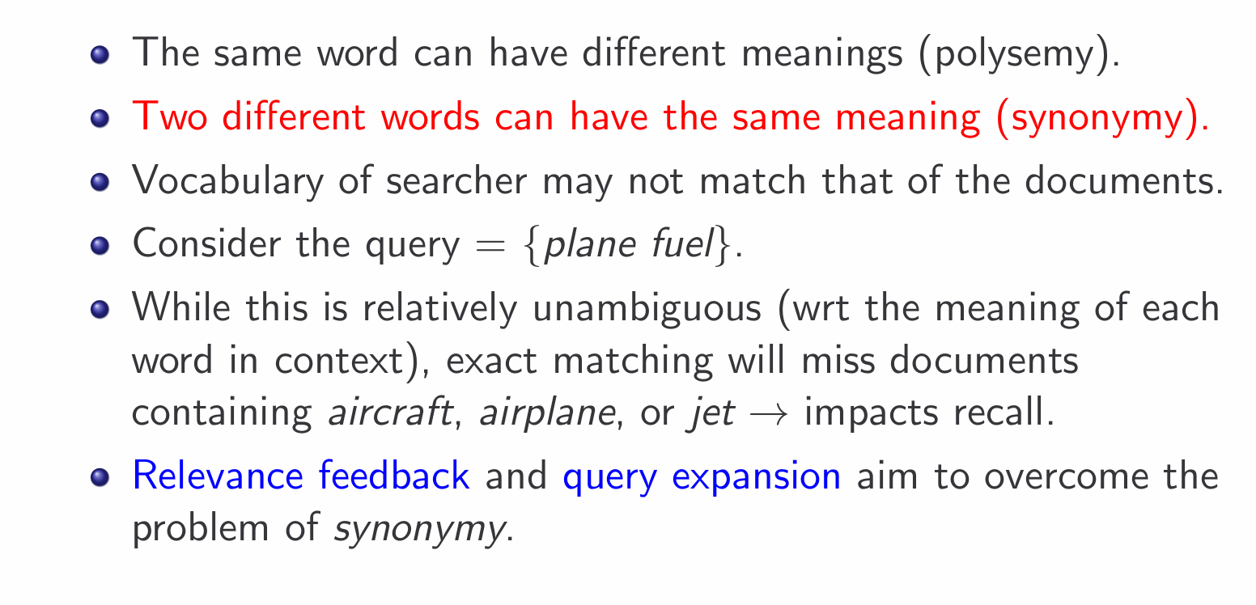

Slide 8
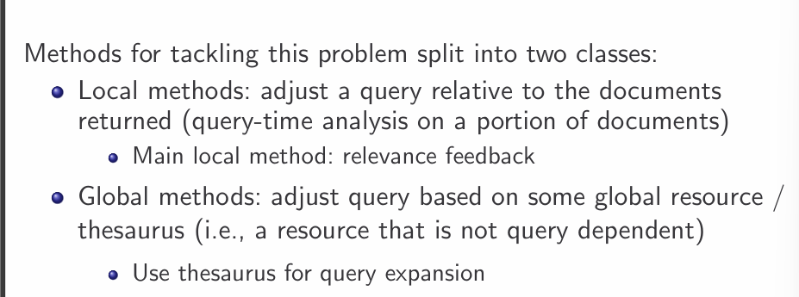
Improving Recall

Slide 9
The idea of relevance feedback (RF) is to involve the user in the retrieval process so as to improve the final result set.
The basic procedure is:
The user issues a (short, simple) query.
The system returns an initial set of retrieval results.
The user marks some returned documents as relevant or nonrelevant.
The system computes a better representation of the information need based on the user feedback.
The system displays a revised set of retrieval results.

Slide 10
When it works
The user has to have sufficient knowledge to be able to make an initial query which is at least somewhere close to the documents they desire.
But It can not work with
Misspellings
Cross-language information retrieval.
Mismatch of searcher’s vocabulary versus collection vocabulary: laptop vs notebook
This approach does not work as well if the relevant documents are a multimodal class, that is, they consist of several clusters of documents within the vector space. This can happen with:
Subsets of the documents using different vocabulary, such as Burma vs. Myanmar
A query for which the answer set is inherently disjunctive, such as Pop stars who once worked at Burger King.
Instances of a general concept, which often appear as a disjunction of more specific concepts, for example, felines.

Slide 11
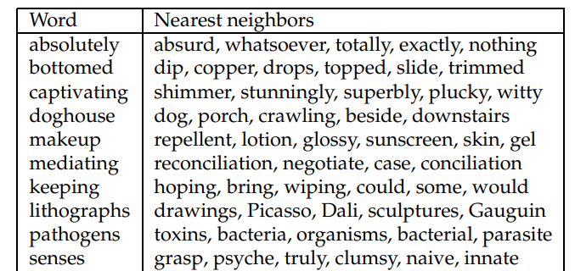
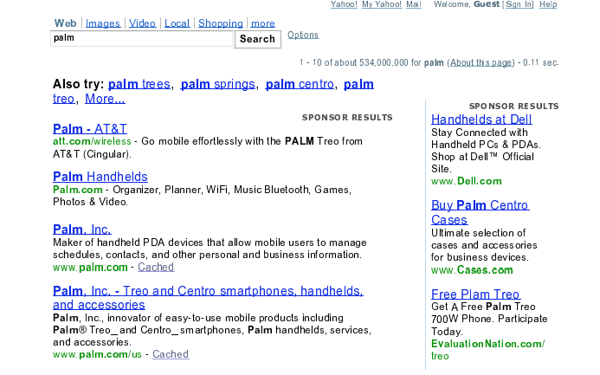
Query Expansion
, users give additional input on query words or phrases, possibly suggesting additional query terms
Different methods for query expansion
Controlled vocabulary
there is a canonical term for each concept
Manual Thesaurus :
human editors have built up sets of synonymous names for concepts, without designating a canonical term.
An automatically derived thesaurus
word co-occurrence statistics over a collection of documents in a domain

Slide 12
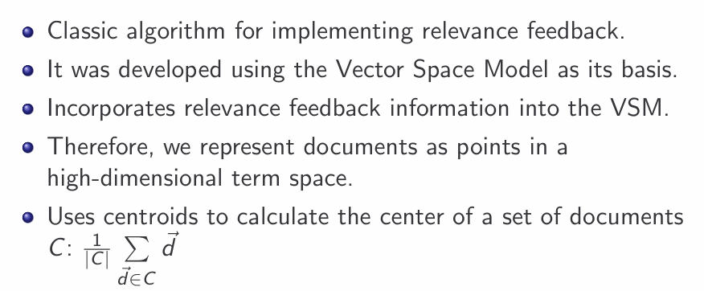
Rocchio algorithm: Basics

Slide 13
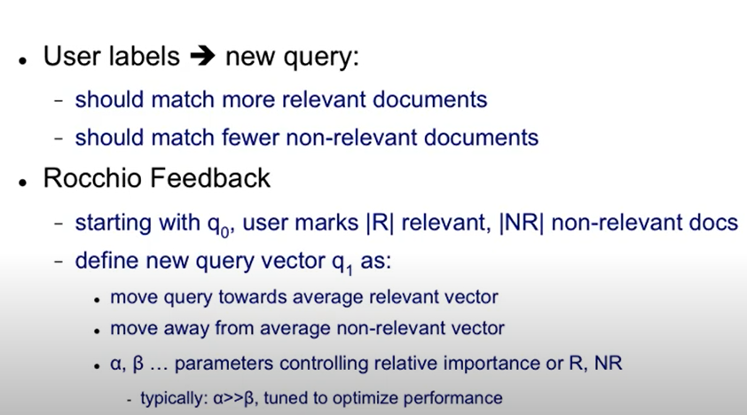

Relevance feedback

Slide 14
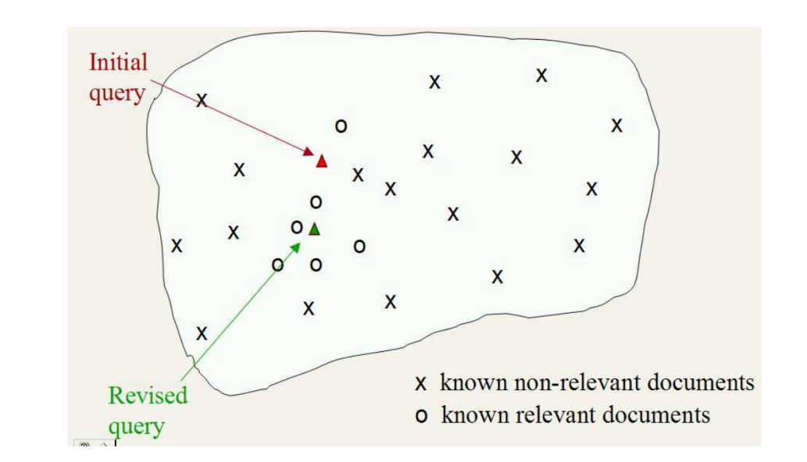
Example of Rocchio

Slide 15
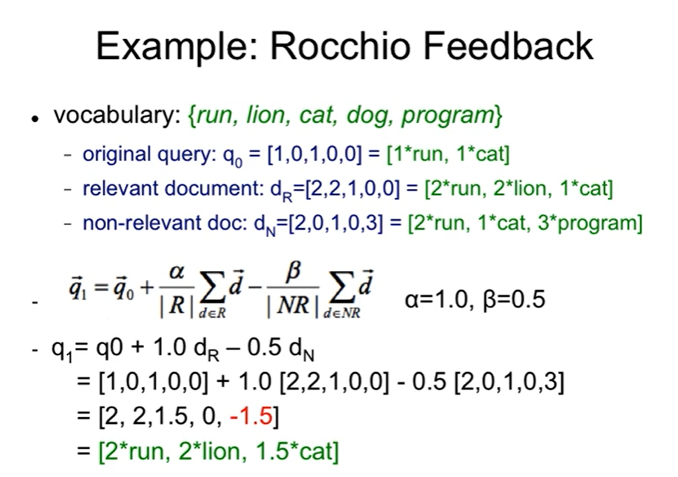

Slide 16
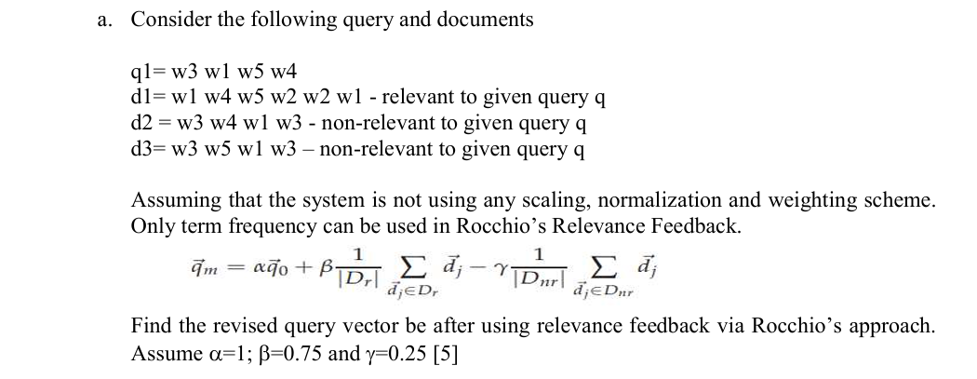


Slide 17
Next topics are Not included in Quiz 2

Slide 18
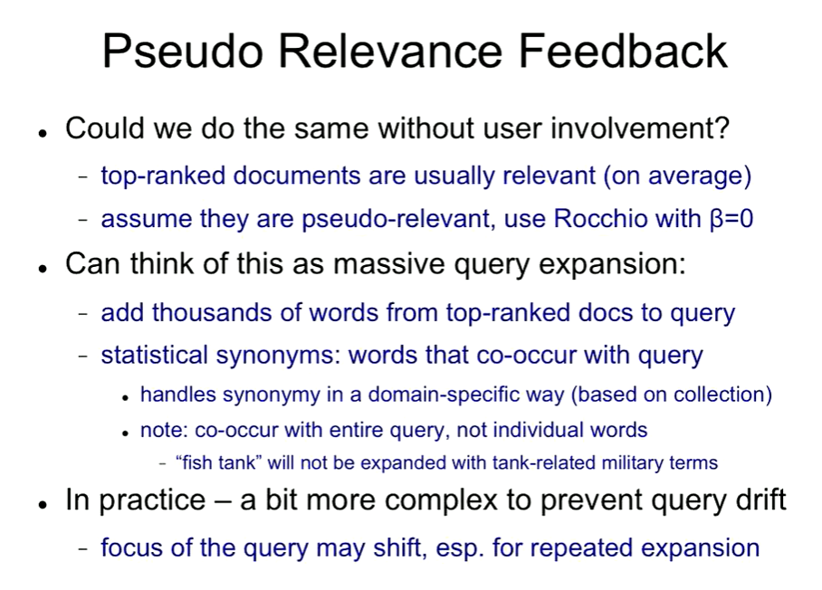
Pseudo relevance feedback , also known as blind relevance feedback , provides a method for automatic local analysis. It automates the manual part of relevance feedback, so that the user gets improved retrieval performance without an extended interaction.

Slide 19
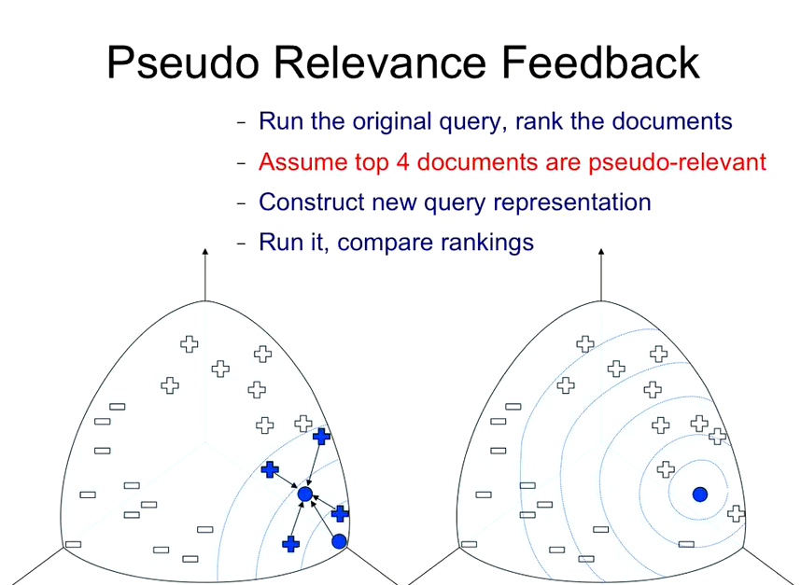

Slide 20
Indirect relevance feedback
We can also use indirect sources of evidence rather than explicit feedback on relevance
This is often called implicit (relevance) feedback . Implicit feedback is less reliable than explicit feedback, but is more useful than pseudo relevance feedback,
while users are often reluctant to provide explicit feedback, it is easy to collect implicit feedback in large quantities for a high volume system, such as a web search engine.
clicks on links were assumed to indicate that the page was likely relevant to the query

Slide 21
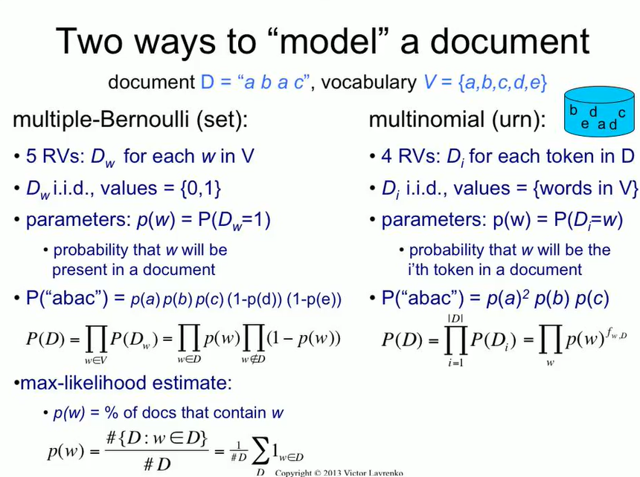

Slide 22
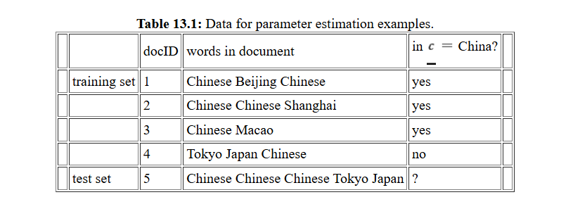
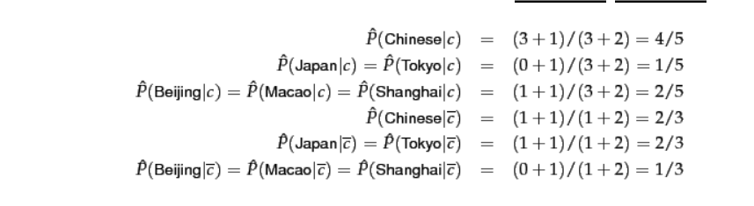
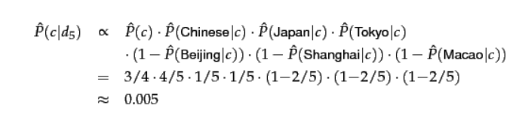


Slide 24
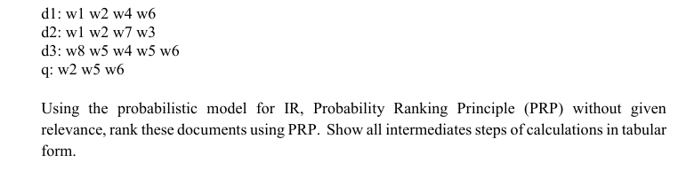
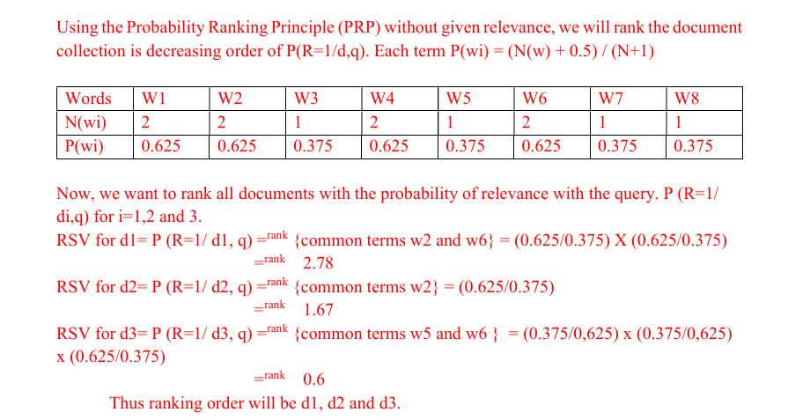
PRP

Slide 25
